Slide 1
Comparison of different machine learning algorithms
Team : east bu
Akash, bhavana, karthik madhuhasa

Slide 2
Comparison table - Type
Algorithm | Type
Linear Regression | Supervised Learning
Logistic Regression | Supervised Learning
SVM | Supervised Learning
K-means | Unsupervised Learning
Naïve Bayes | Supervised Learning
Decision Tree | Supervised Learning
Random Forest | Supervised Learning
Supervised Learning : A supervised learning algorithm
analyzes the training data and produces an inferred function,
which can be used for mapping new examples
Unsupervised Learning : Unsupervised learning is a type of
machine learning algorithm used to draw inferences from datasets
consisting of input data without labeled responses

Slide 3
Comparison table - application
Algorithm | Application
Linear Regression | Regression
Logistic Regression | Classification
SVM | Both Classification and Regression
K-means | Clustering
Naïve Bayes | Both Classification and Regression
Decision Tree | Both Classification and Regression
Random Forest | Both Classification and Regression
Regression : The output is usually a numerical value.
Eg: Predicting height of a person given weight and age
Classification : The output is the name of the class
to which the data-point belong. Eg: Yes or No
Clustering : It is similar to classification but with no labels.
Eg: Clustering different groups of people

Slide 4
Comparison table – Advantages and disadvantages
Algorithm | Advantages | Disadvantages
Linear Regression | Easy to implement and understand | Efficiency is very low as most of the problem are non-linear in nature
Logistic Regression | Easy to scale up the model | The performance reduces with increased decision boundaries
SVM | High Accuracy, Mainly used in NLP | Selecting the kernel is difficult. High-Dimensional spaces difficult to visualize, Memory intensive
K-means | Faster Computation | Difficult to predict the value of K Initial centroid can affect the accuracy
Naïve Bayes | It works well with small datasets | It assumes features to be independent Unbalanced dataset leads to poorer accuracy.
Decision Tree | Good visualization | Need to build the tree each time new examples comes
Random Forest | Fast and highly scalable . Does not overfit | Its very complex and time consuming

Slide 5
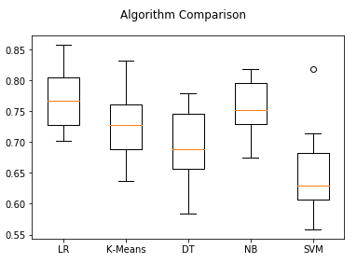
Diabetes Dataset predict the Outcome, whether the patient is diabetic or not based on their age, BMI, insulin level, no. of pregnancies and so on
Algorithms : RA (Mean, STD)
Logistic Regression : 0.769515 (0.048411)
K – Means : 0.726555 (0.061821)
Decision Trees : 0.700427 (0.063340)
Naïve Bayes : 0.755178 (0.042766)
SVM : 0.651025 (0.072141)

Slide 6
Thank you

